Slide 1

BRUM BREATHES
BIRMINGHAM’S JOURNEY TO CLEAN AIR
Jemma Callow & Gareth Wood
Birmingham Clean Air Zone
27 April 2021

Slide 2
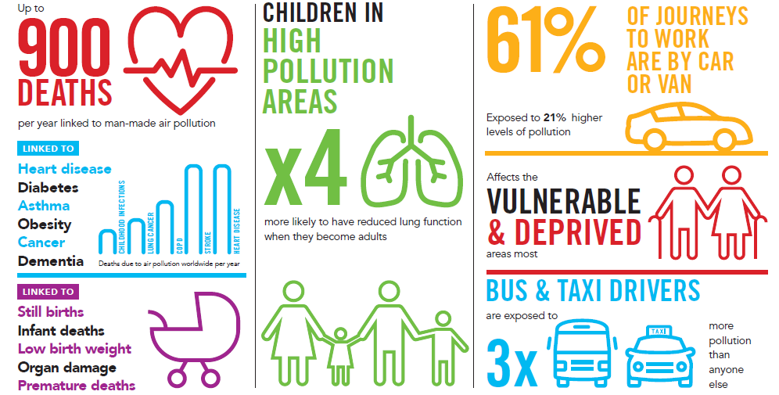
The impact of poor air quality

Slide 3
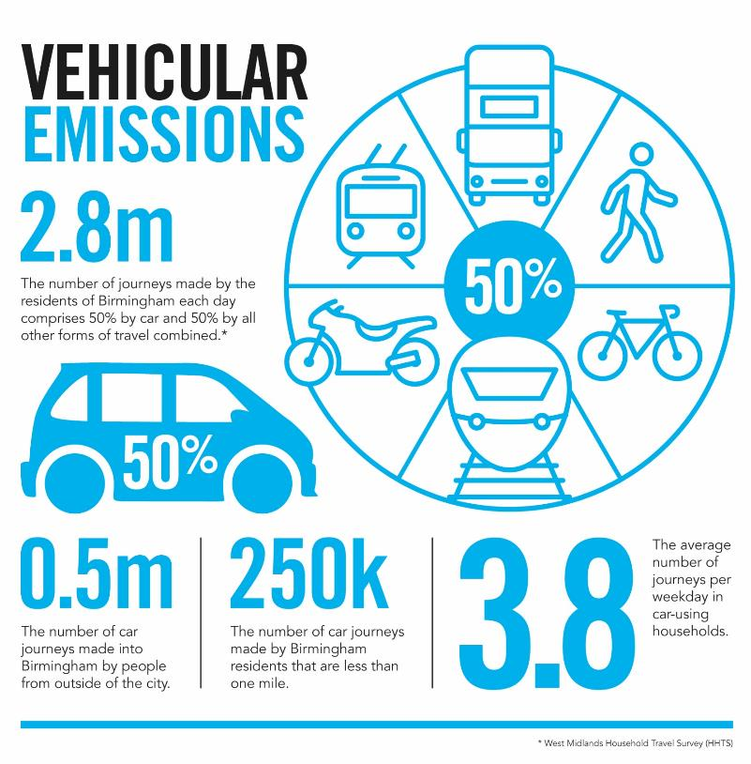
The causes of poor air quality

Slide 4
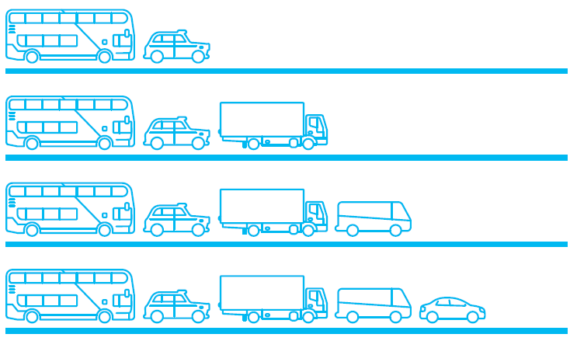
Tackling poor air quality
Clean Air Zones
A Clean Air Zone defines an area where targeted action is taken to improve air quality and resources are prioritised and coordinated in order to shape the urban environment in a way that delivers improved health benefits and supports economic growth.
Non-charging Clean Air Zone
Chargeable Clean Air Zones
These are defined geographic areas used as a focus for action to improve air quality.
This action can take a range of forms but does not include charge based access restrictions
A
B
C
D

Slide 5

Birmingham’s Clean Air Zone
TYPE D
Includes all vehicle types
Daily charge will apply 24 hours a day
Cars, taxis, vans
HGVs, coaches and buses
£8
£50
Drivers must pay within an allocated payment window
Key messages:
  Payment online or over the phone using the Government payment system (www.gov.uk/clean-air-zones)
  Must pay six days prior to their visit; the day of their visit or six days after (13 day payment window)
  Failure to pay will incur a Fixed Penalty Notice of £120 (reduced to £60 if paid in 14 days)
  Onus will be on the driver to know they have entered the zone; they will not receive a letter or text

Slide 6
Vehicles that won’t be charged
Compliant vehicles
Vehicles that meet specific emission standards will not be charged to enter the Clean Air Zone and will not need to take any action
EXAMPLES
Euro 4 petrol or better
(most vehicles from 2006 onwards)
Euro 6 diesel or better (most vehicles from September 2015 onwards)
Gas Euro 6 standard or better
Hybrid electric (diesel/ petrol engines must meet relevant Euro standard)
Fully electric vehicle
Fully Hydrogen fuel cell

Slide 7





Clean Air Zone revenue
Revenue generated to be re-invested in transport-related projects and policies
Options identified so far include:
Controlled parking zones to mitigate localised impact
Funding for the Hydrogen bus pilot
City centre pedestrianisation and public realm improvements
Enhanced programme of active and sustainable travel

Slide 8
Measures to support the introduction of the
Clean Air Zone
Exemptions
From the launch of the Clean Air Zone on 1 June 2021
SHORT TERM
2
1
YEARS
YEAR
Residents within the Clean Air Zone
Individuals travelling into the Clean Air Zone for work and earning less than £30,000 a year
Commercial vehicles registered within
the Clean Air Zone
Visitors to hospitals
Applications and all supporting evidence to be provided by 10 May 2021 to be processed in time for launch

Slide 9
Measures to support the introduction of the
Clean Air Zone
Exemptions
From the launch of the Clean Air Zone on 1 June 2021
ONGOING
Vehicles with disabled or
disabled passenger tax class
Motorcycles
Show
vehicles
Historic
vehicles
Specialist
vehicles
Community and
School Transport

Slide 10
Measures to support the introduction of the
Clean Air Zone
SCRAPPAGE SCHEME AND MOBILITY CREDITS
£10m
People working in the Clean Air Zone earning
< £30k p.a.
Financial incentives
35
UPGRADE AND REPLACE
£
m
£10m
SMEs in the West Midlands with HGVs and coaches
Total package of grants
UPGRADE AND REPLACE
£15m
Birmingham-licensed hackney carriage and private hire drivers

Slide 11




The bigger picture
BIRMINGHAM’S TRANSPORT PLAN
Published for consultation in January 2020
The vision
A smart, innovative, carbon neutral and low emission transport network that will support sustainable and inclusive economic growth, tackle climate change and promote the health and well-being of Birmingham’s citizens.
Delivered through four ‘big moves’
Reallocate road space
Transform the city centre
Prioritise active travel
Manage demand

Slide 12
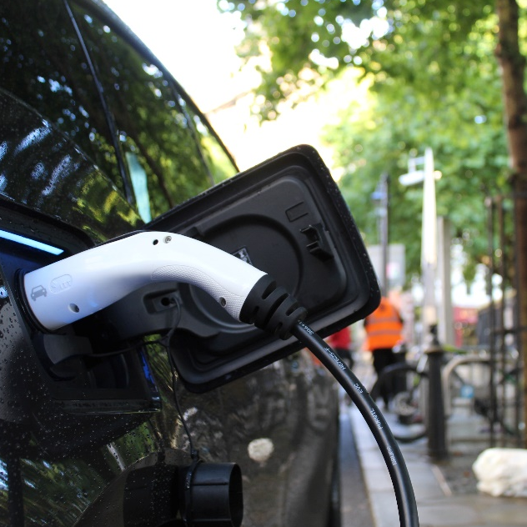
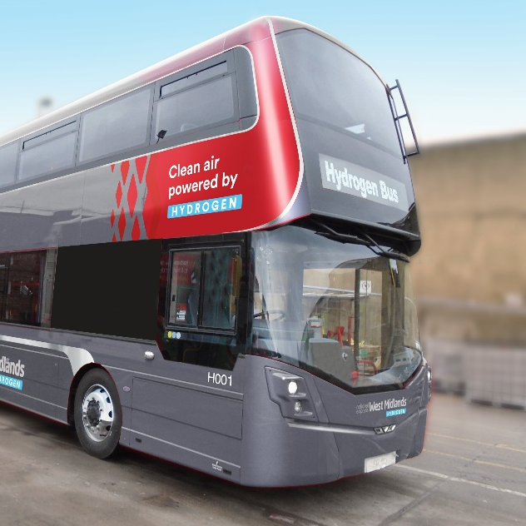
The Clean Air Zone as an enabler of change
A long term ambition for zero emissions
The council is committed to taking a leading role, playing its part, and working with individuals, communities, businesses, partners, and others across the city and region to act now on the causes and impacts of the climate emergency.
The ambition was set for the council and city to become net zero carbon by 2030. This is the city’s ‘route to zero’ (R20).
Additional programmes supported by the Clean Air Zone team include:
Significant expansion of the city’s electric vehicle charging points
Purchase of 20 hydrogen buses to encourage the adoption of the technology in the city
Purchase of up to 50 electric hackney carriages to encourage adoption of this technology within the taxi fleet

Slide 13
STAY CONNECTED
brumbreathes.co.uk
cleanair@birmingham.gov.uk
@BhamConnected
@birminghamconnected

